Slide 1
Voting Districts Formation
City Council Meeting/ Public Hearing
Monday, April 20, 2015
6:30 pm

Slide 2
VDF Presentation
City of Whittier’s Voting Districts Formation (VDF) Community Participation Plan Update
Summary of community feedback
Presentation of four proposals
Analysis and considerations
Questions & Answers

Slide 3
Community Participation Plan, Oct. 2014 – April 2015
Two rounds of public involvement activities
Round One (Oct. – Dec. 2014)
Objective: Gain an understanding of how the community views communities of interest, natural barriers and boundaries.
23 Meet the Expert Meetings (individual and group meetings)
3 Community Meetings (30-50 participants per meeting)
Round 2 (Jan. – April 2015)
Objective: Gain an understanding of the community's perspective on the sample maps (A, B, C, D and six public submissions).
10 Meet the Expert Meetings (individual and group meetings)
3 Community Meetings (30-40 participants per meeting)

Slide 4
Round 2, Community Feedback
Consensus:
Majority of speakers supported separating areas of high voter turnout from areas of low voter turnout
Most participants noted a bond between communities north and south of Whittier Boulevard in East Whittier
Support for an economic engine within each district
Map preferences
High level of support - PS-009-Snyder-c
Contrasting support - Draft Proposal B and PS-14-Greene-c
Low level of support - Draft Proposal A
Contrasting support/opposition – Draft Proposal D

Slide 5
Proposal Development Considerations
Legal Requirements
Geography
Neighborhoods
Physical Layout
School Districts and Other Areas
Political Participation
Voter Registration
Voter Turnout
Latino Share
Socio-Economic Characteristics
Income
Home Ownership
Age of Housing
Length of Residence
Public Input

Slide 6
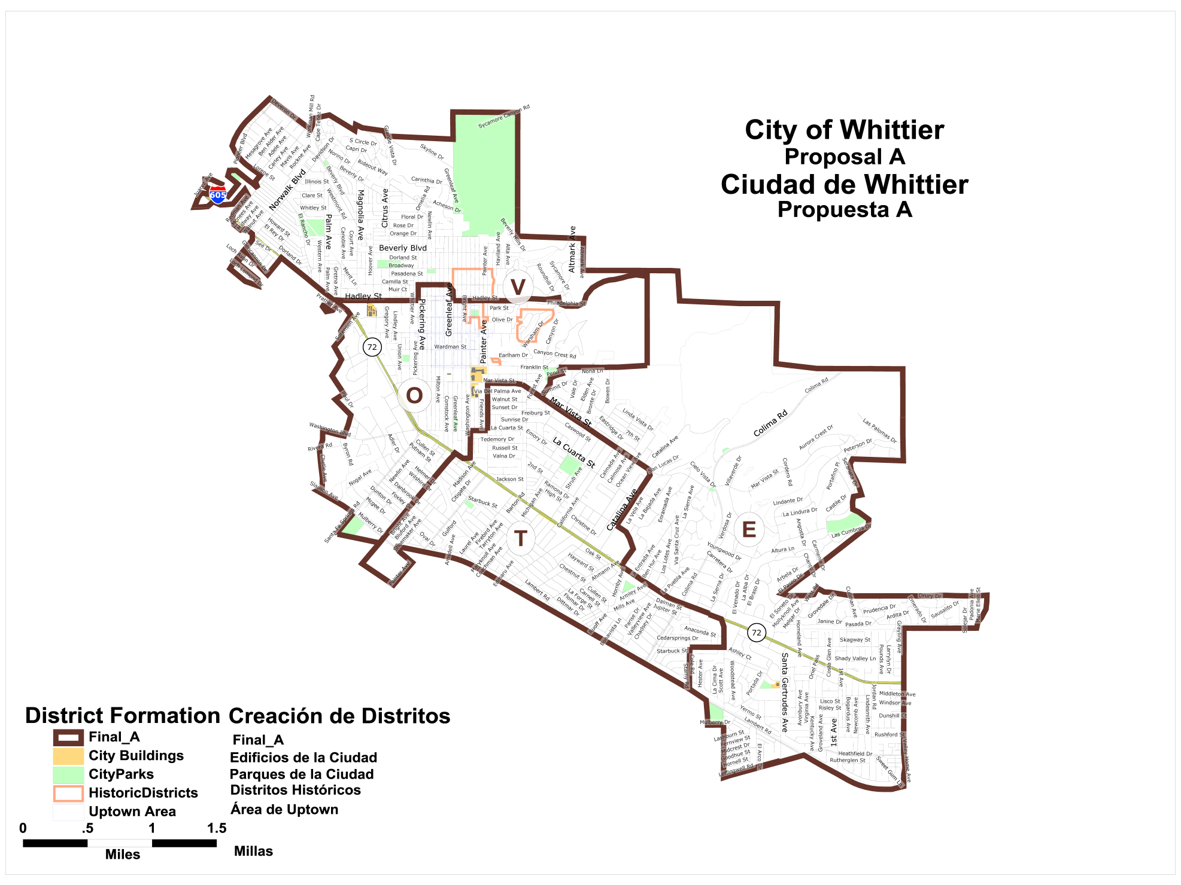
Proposal A

Slide 7
Proposal B

Slide 8
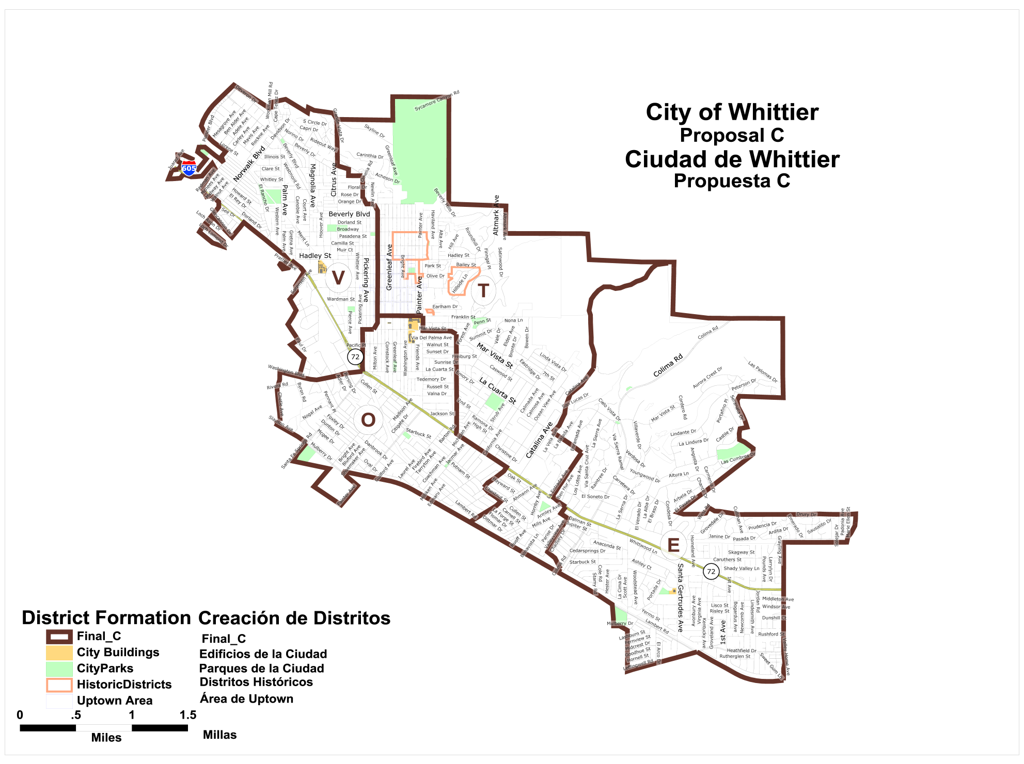
Proposal C

Slide 9
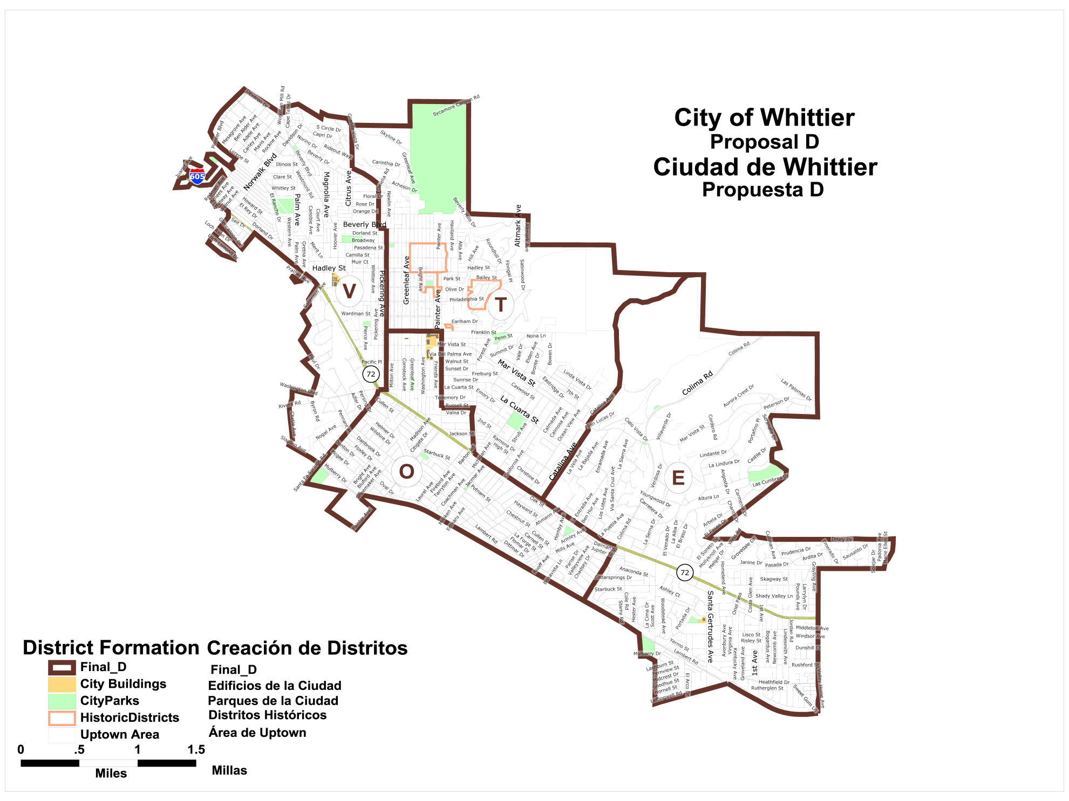
Proposal D

Slide 10
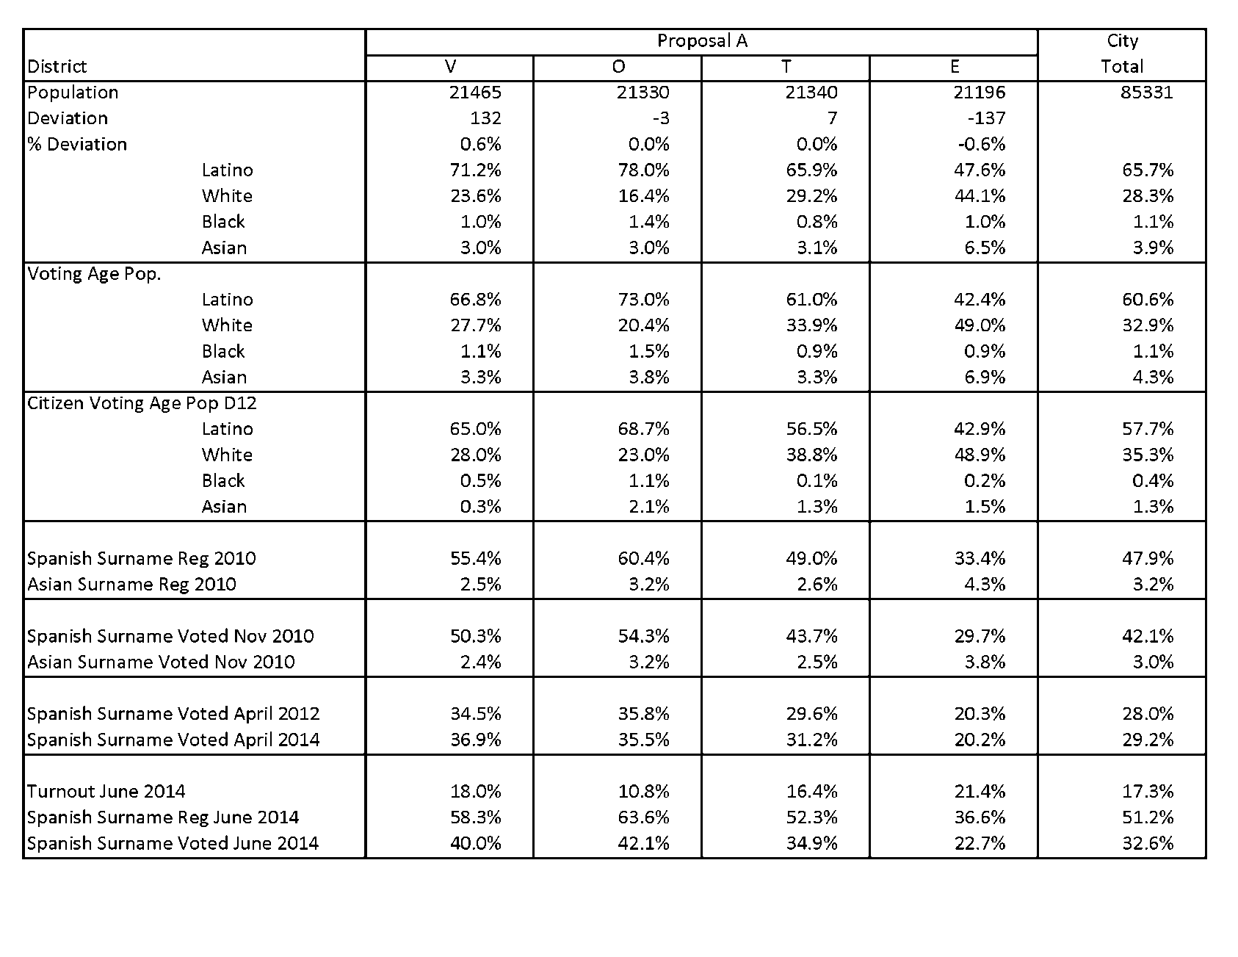
Proposal A Data
Notes:
Dave

Slide 11
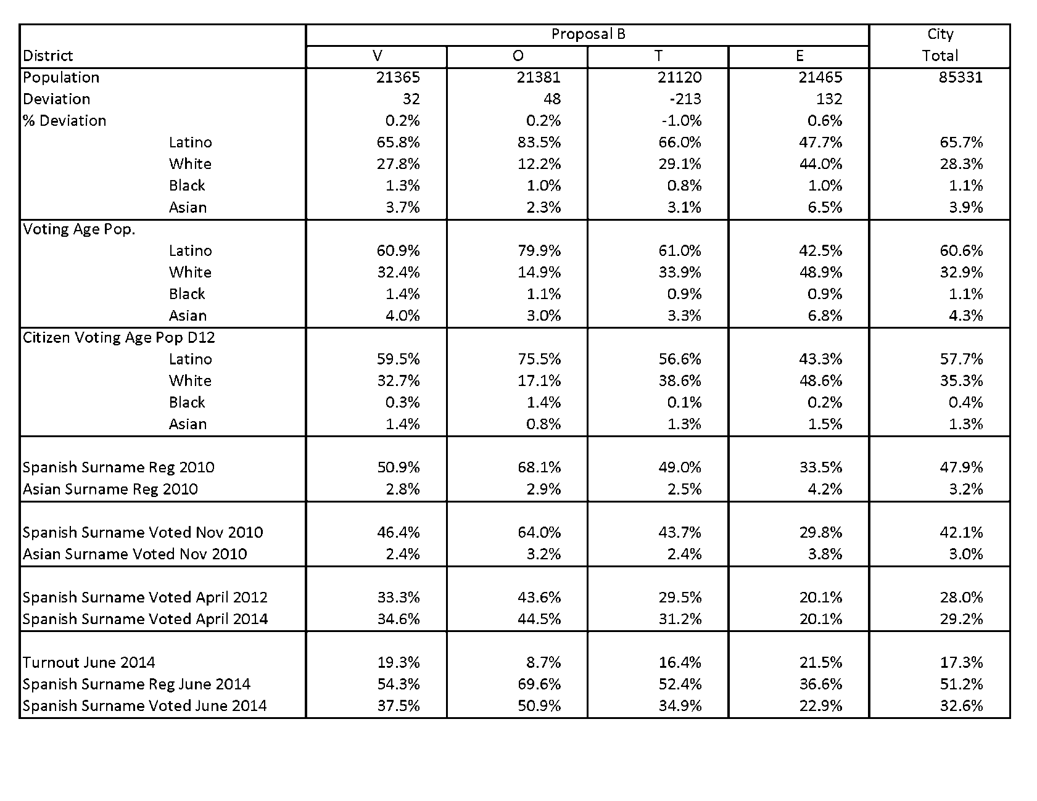
Proposal B Data
Notes:
Dave

Slide 12
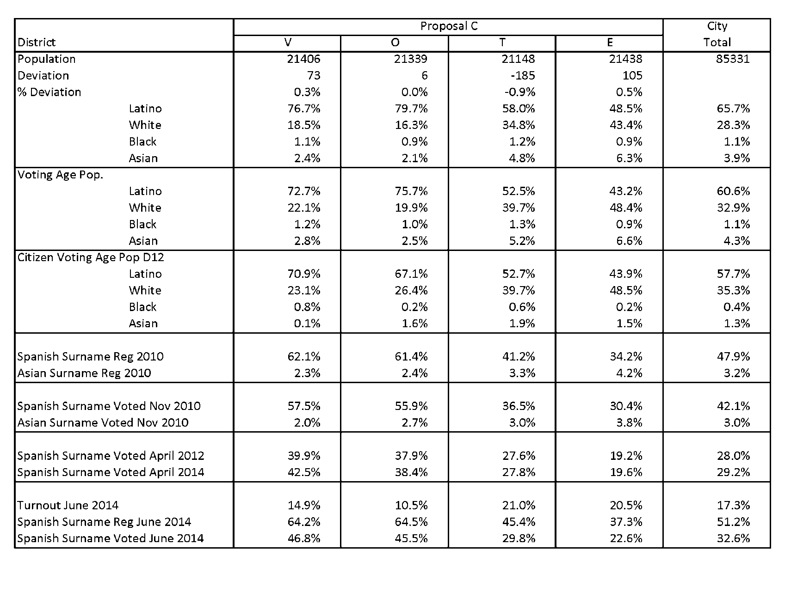
Proposal C Data
Notes:
Dave

Slide 13
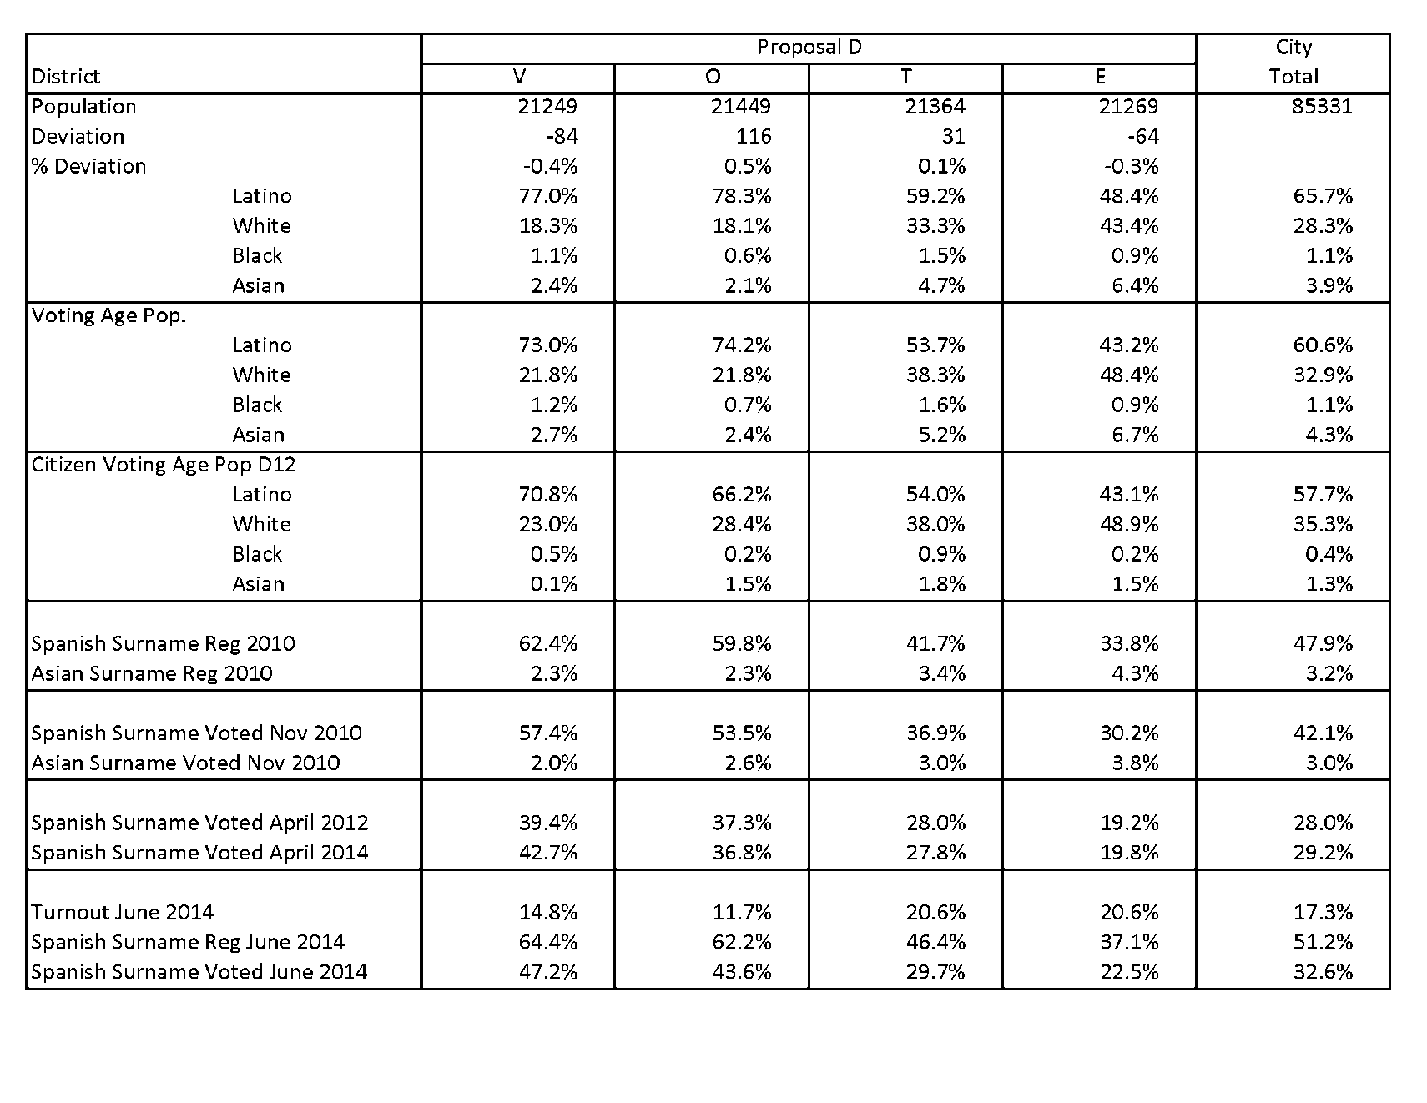
Proposal D Data
Notes:
Dave

Slide 14
Thank you

