Slide 1
Voting Districts Formation
Welcome
Saturday, November 15, 2014
9:00 a.m. to 11:00 a.m.
Uptown Senior Center
13225 Walnut Street
Wednesday, November 19, 2014
6:30 p.m. to 8:30 p.m.
Palm Park
5703 Palm Avenue
Thursday, November 20, 2014
6:30 p.m. to 8:30 p.m.
Parnell Park
15390 Lambert Road
Notes:
Welcome and Team introductions

Slide 2
Purpose of Today’s Meeting
City of Whittier’s Voting Districts Formation (VDF)
Background & Overview
Guiding Principles
Process and Timeline
Criteria, Considerations and Sample Maps
Next Steps
Group Exercise to Gather Community Input
Questions & Answers

Slide 3
VDF Background & Overview
City of Whittier’s at-large voting structure
Approval of Measure W (June 2014)
Council representatives to be voted by and from four geographically defined districts
Council Member living in the district will serve for a four-year term
Mayor elected by the City-wide vote
Serves for a two-year term
Notes:
- Current voting structure – explain how city council is voted by city wide voting structure and the mayor/mayor pro-tem rotation
- With the Approval of Measure W in 2014 the voting structure is changed to allow council representatives to be voted by and from geographically defined areas. The purpose of the geographic division is to ensure the elected representatives are reflective of their constituents who live in the same district. This changed the way the city leadership will be elected, starting in 2016 and thereafter
The City Mayor will be elected by a city-wide vote for a two term

Slide 4
VDF Guiding Principles
Process will be transparent and inform/engage all stakeholders.
Public input focus on formation of four voting districts in compliance with laws.
All input considered with respect for differing opinions.
Near equal population is primary factor; also, topography, geography, communities of interest, and significant and sensitive land uses; where council members reside is also legally permissible to consider.
Minority communities should not be diluted.
Districts 1 and 3 elected in April 2016; Districts 2 and 4 elected in April 2018. City Council will approve districts/number designation.
Notes:
A list of Guiding Principles has been developed to guide both the technical and community participation processes. The guidelines that frame how the public will participate and outline a decision making structure in the City’s effort to develop community supported voting districts. You should have received a copy of the guiding principles, there is also a board in the back of the room, in the interest of time, I summarized them in this slide.

Slide 5
VDF Process and Anticipated Schedule
Parallel Technical and Community Participation Processes
Technical Process (Oct 2014 thru April 2015)
Demographic Analysis (specific criteria including: population, topography, geography, communities of interest, etc. )
Formation of four nearly equal population districts
Community Participation (Oct 2014 thru April 2015)
October 2014 - Meet the Expert meetings
November 2014 – Community meetings, Round 1 (Senior Center, Palm and Parnell Parks)
December 9, 2014 – City Council public hearing to receive public input on proposed maps
Early 2015 – Round 2 Meet the Expert one-on-one and Community meetings
March/April 2015 – Present final analysis with recommendation for four voting districts to City Council and adopt Voting Districts
Notes:
Yesenia
Technical process is focused on data analysis
Community Participation is focused on the realities of Whittier that the data cannot show
Once the processes are complete; Elections 2016, residents/candidates of specific districts who choose to run will provide direct representation of the unique population, issues and challenges facing that particular district, because of their understanding of the geographical area they represent.

Slide 6
Criteria
Federal Requirement
1 | Equal Population | As equal as practical based on data and Criteria
 |  | Based on most recent Census Total Population
2 | Minority Voting Rights | No Discriminatory Purpose
 |  | No Vote Dilution: Narrowly Tailored
3 | Equal Protection | Race must not Predominate
State Law
a | Topography
b | Geography
c | Cohesiveness, contiguity, integrity, and compactness of territory
d | Community of Interest

Slide 7
Demographic Data
2010 Census PL94-171: Redistricting Data File
Population | Total | NH White | Latino | NH Black | NH Asian
 | 85331 | 28.3% | 65.7% | 1.1% | 3.9%
Ideal District Population | 21333
Voting Age Population |  | NH White | Latino | NH Black | NH Asian
 |  | 32.9% | 60.6% | 1.1% | 4.3%
2012 5 Year American Community Survey: DOJ Special Tabulation
Citizen Voting Age Population |  | NH White | Latino | NH Black | NH Asian
 |  | 35.3% | 57.7% | 0.4% | 1.3%
Statewide Database
 |  | Spanish Surnamed |  | Asian Surnamed
Nov 2010 Registered Voters |  | 47.9% |  | 3.2%
Nov 2010 Actual Voters |  | 42.1% |  | 3.0%
Compass Demographics - City Clerk
 |  | Spanish Surnamed
April 2012 Actual Voters |  | 28.0%
April 2014 Actual Voters |  | 29.2%
June 2014 Turnout |  | 17.3%
June 2014 Registered Voters |  | 51.2%
June 2014 Actual Voters |  | 32.6%
Notes:
Dave

Slide 8
Geographic Data
Streets and Highways
Census Tracts and Blocks
Precincts
Parcels
City GIS Layers
School District Boundaries
Attendance Areas
Notes:
Dave

Slide 9
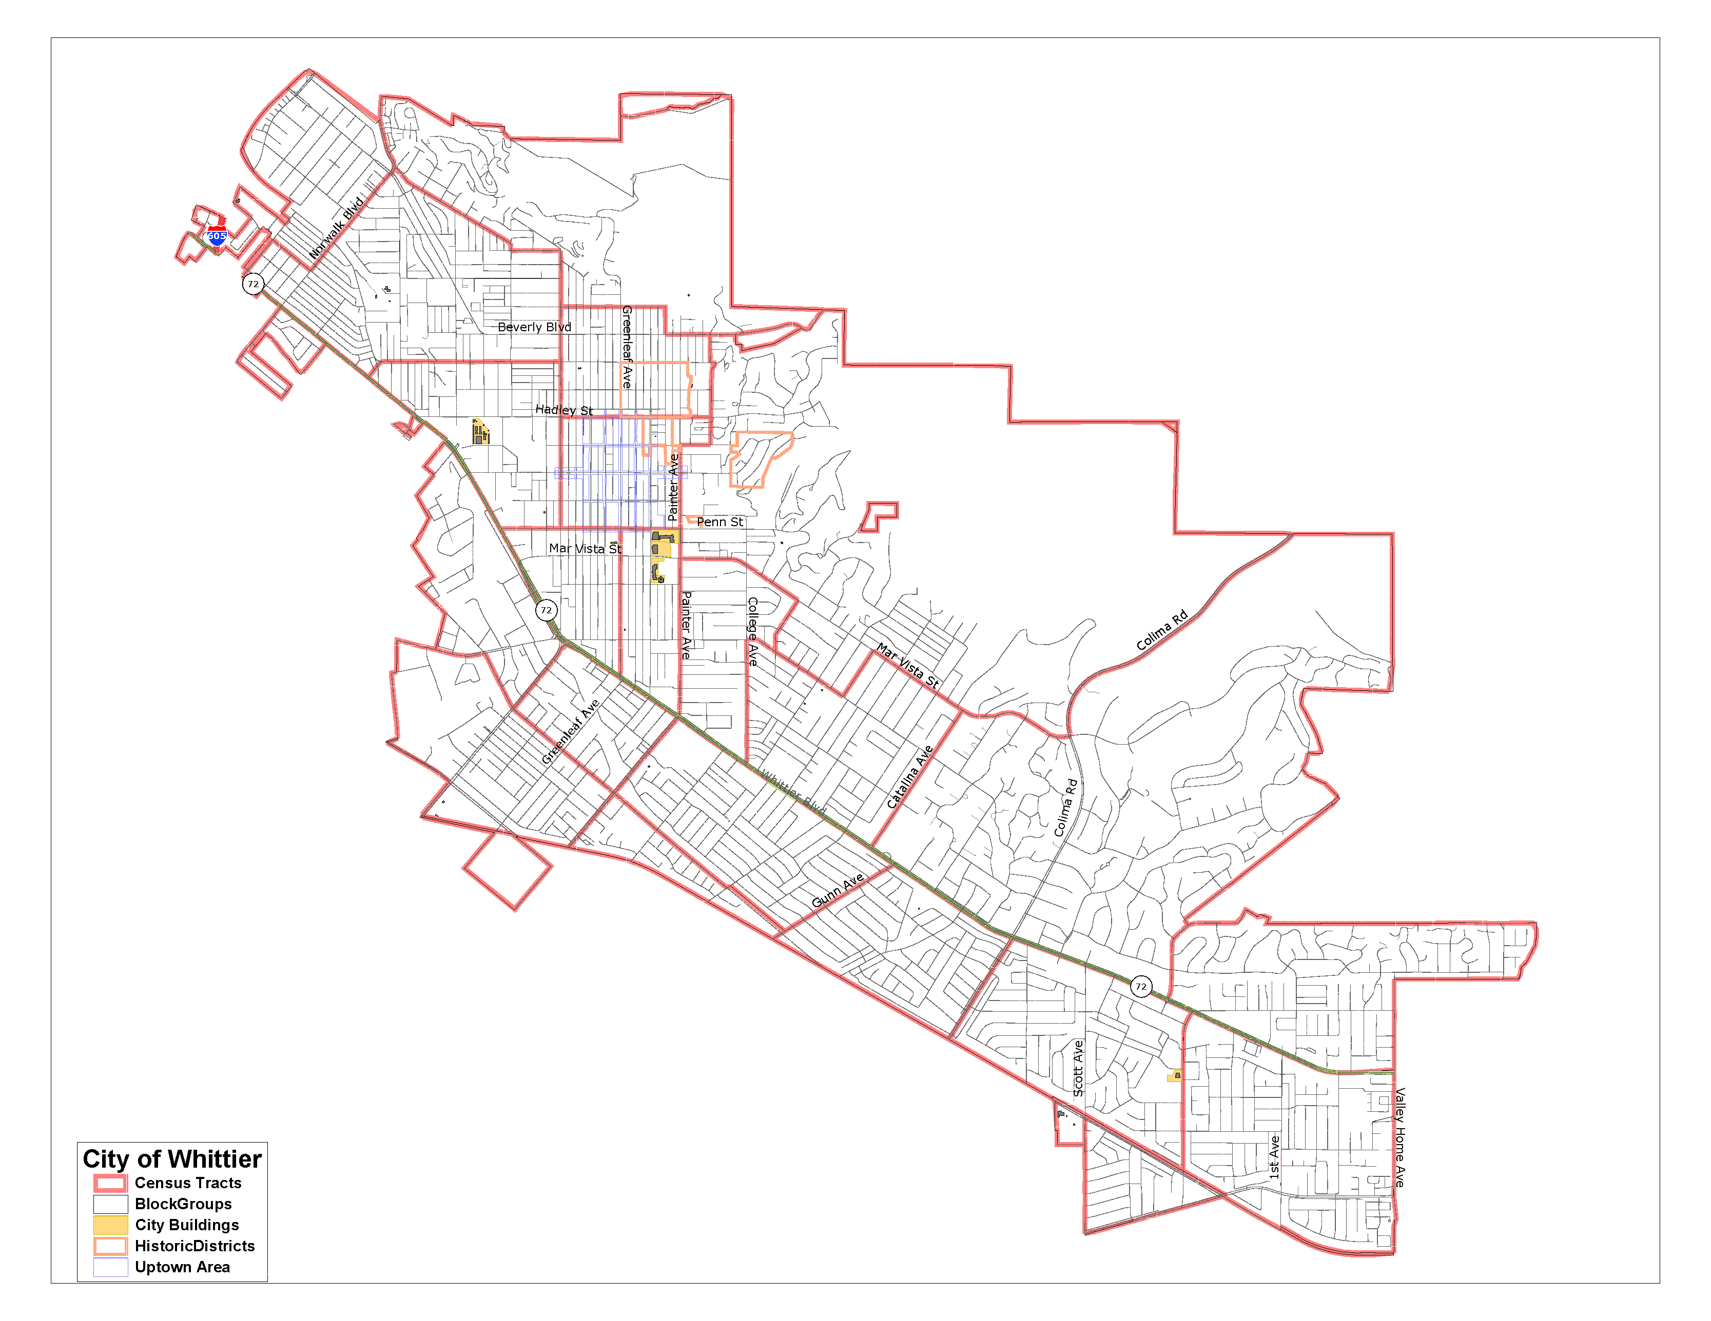
Base Map
Notes:
Dave

Slide 10
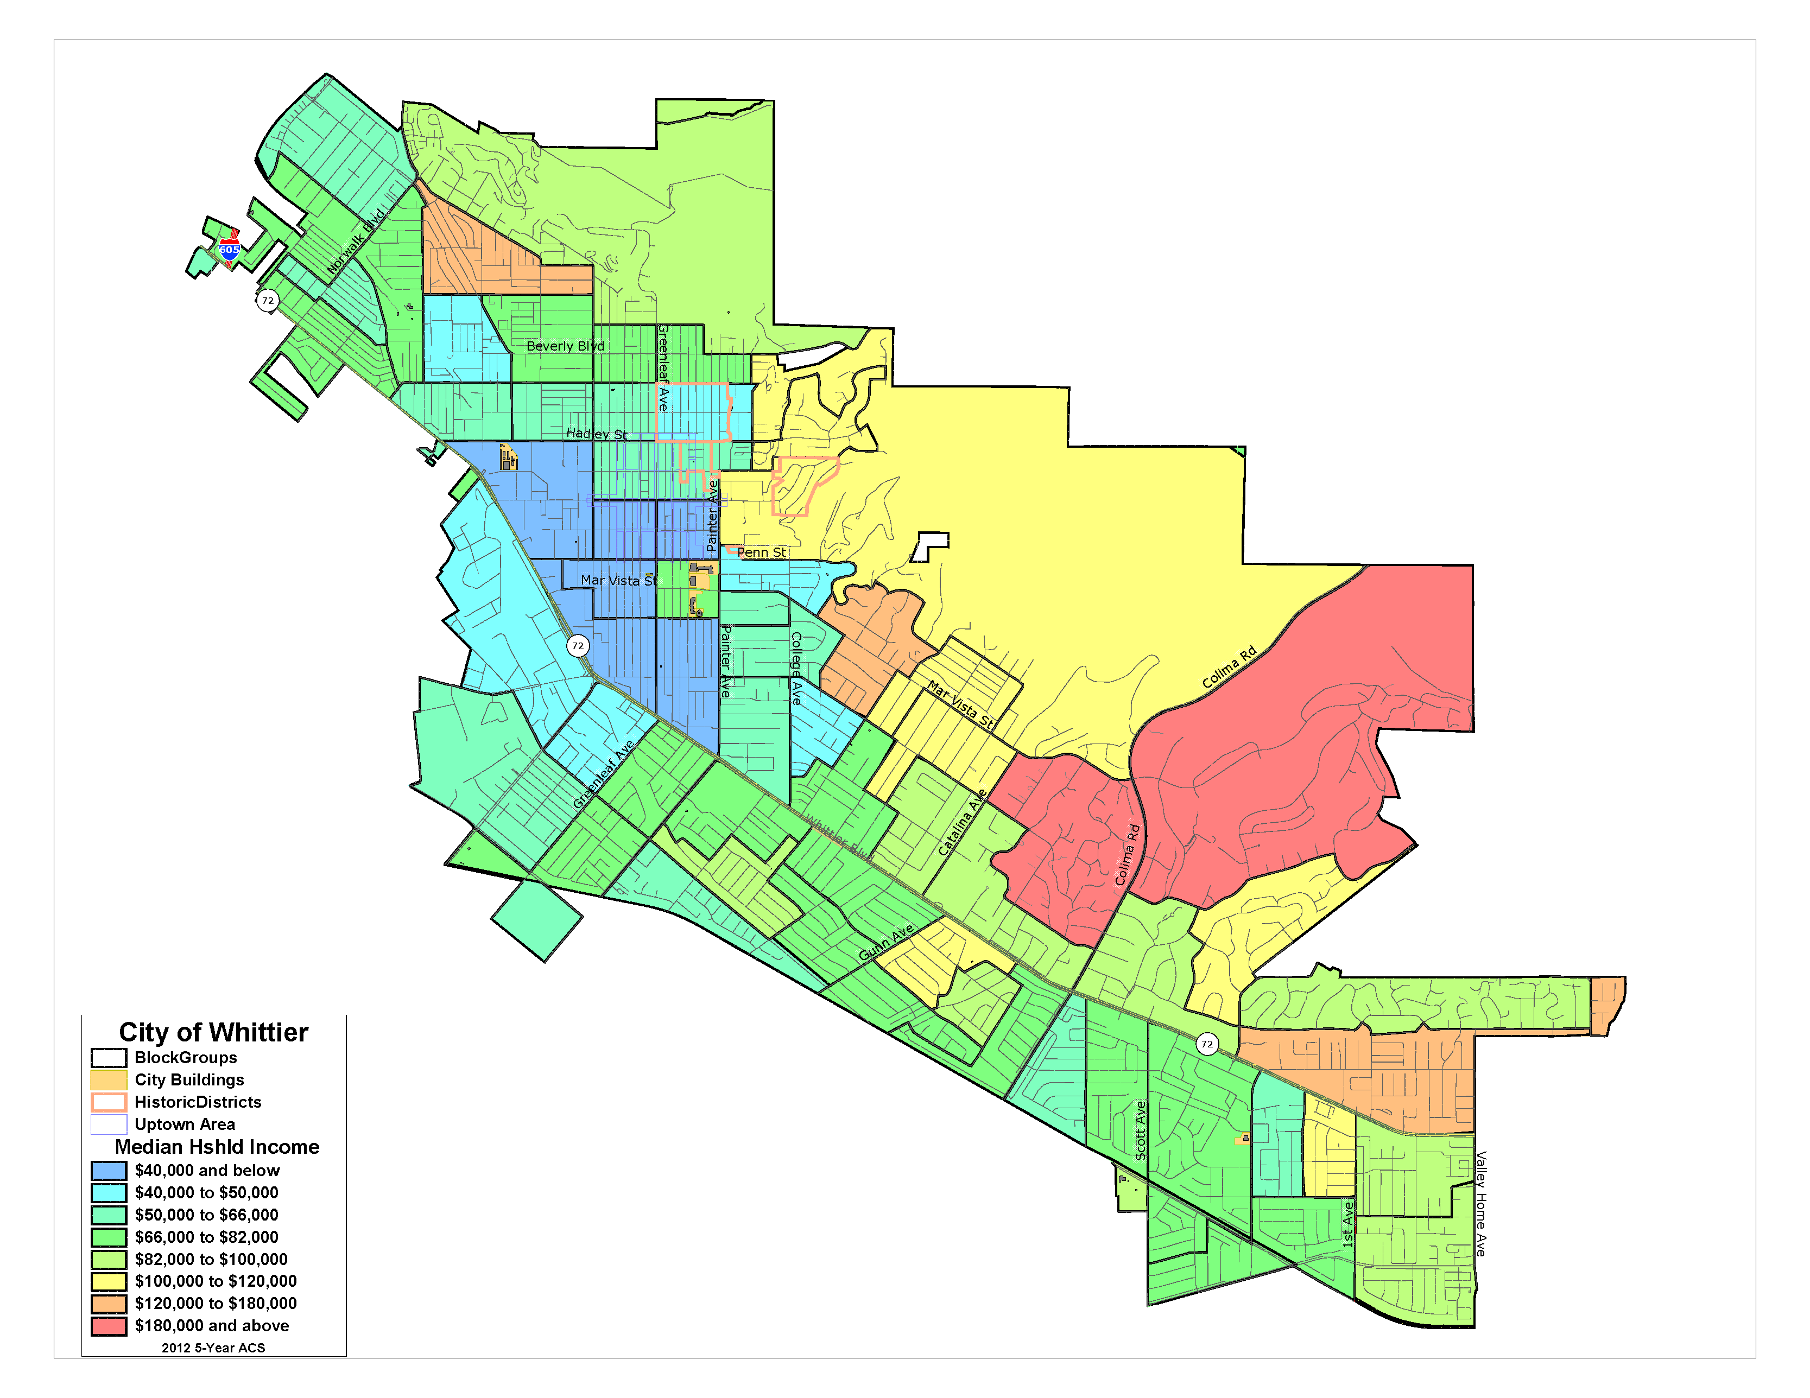
Median Household Income
Notes:
Dave

Slide 11
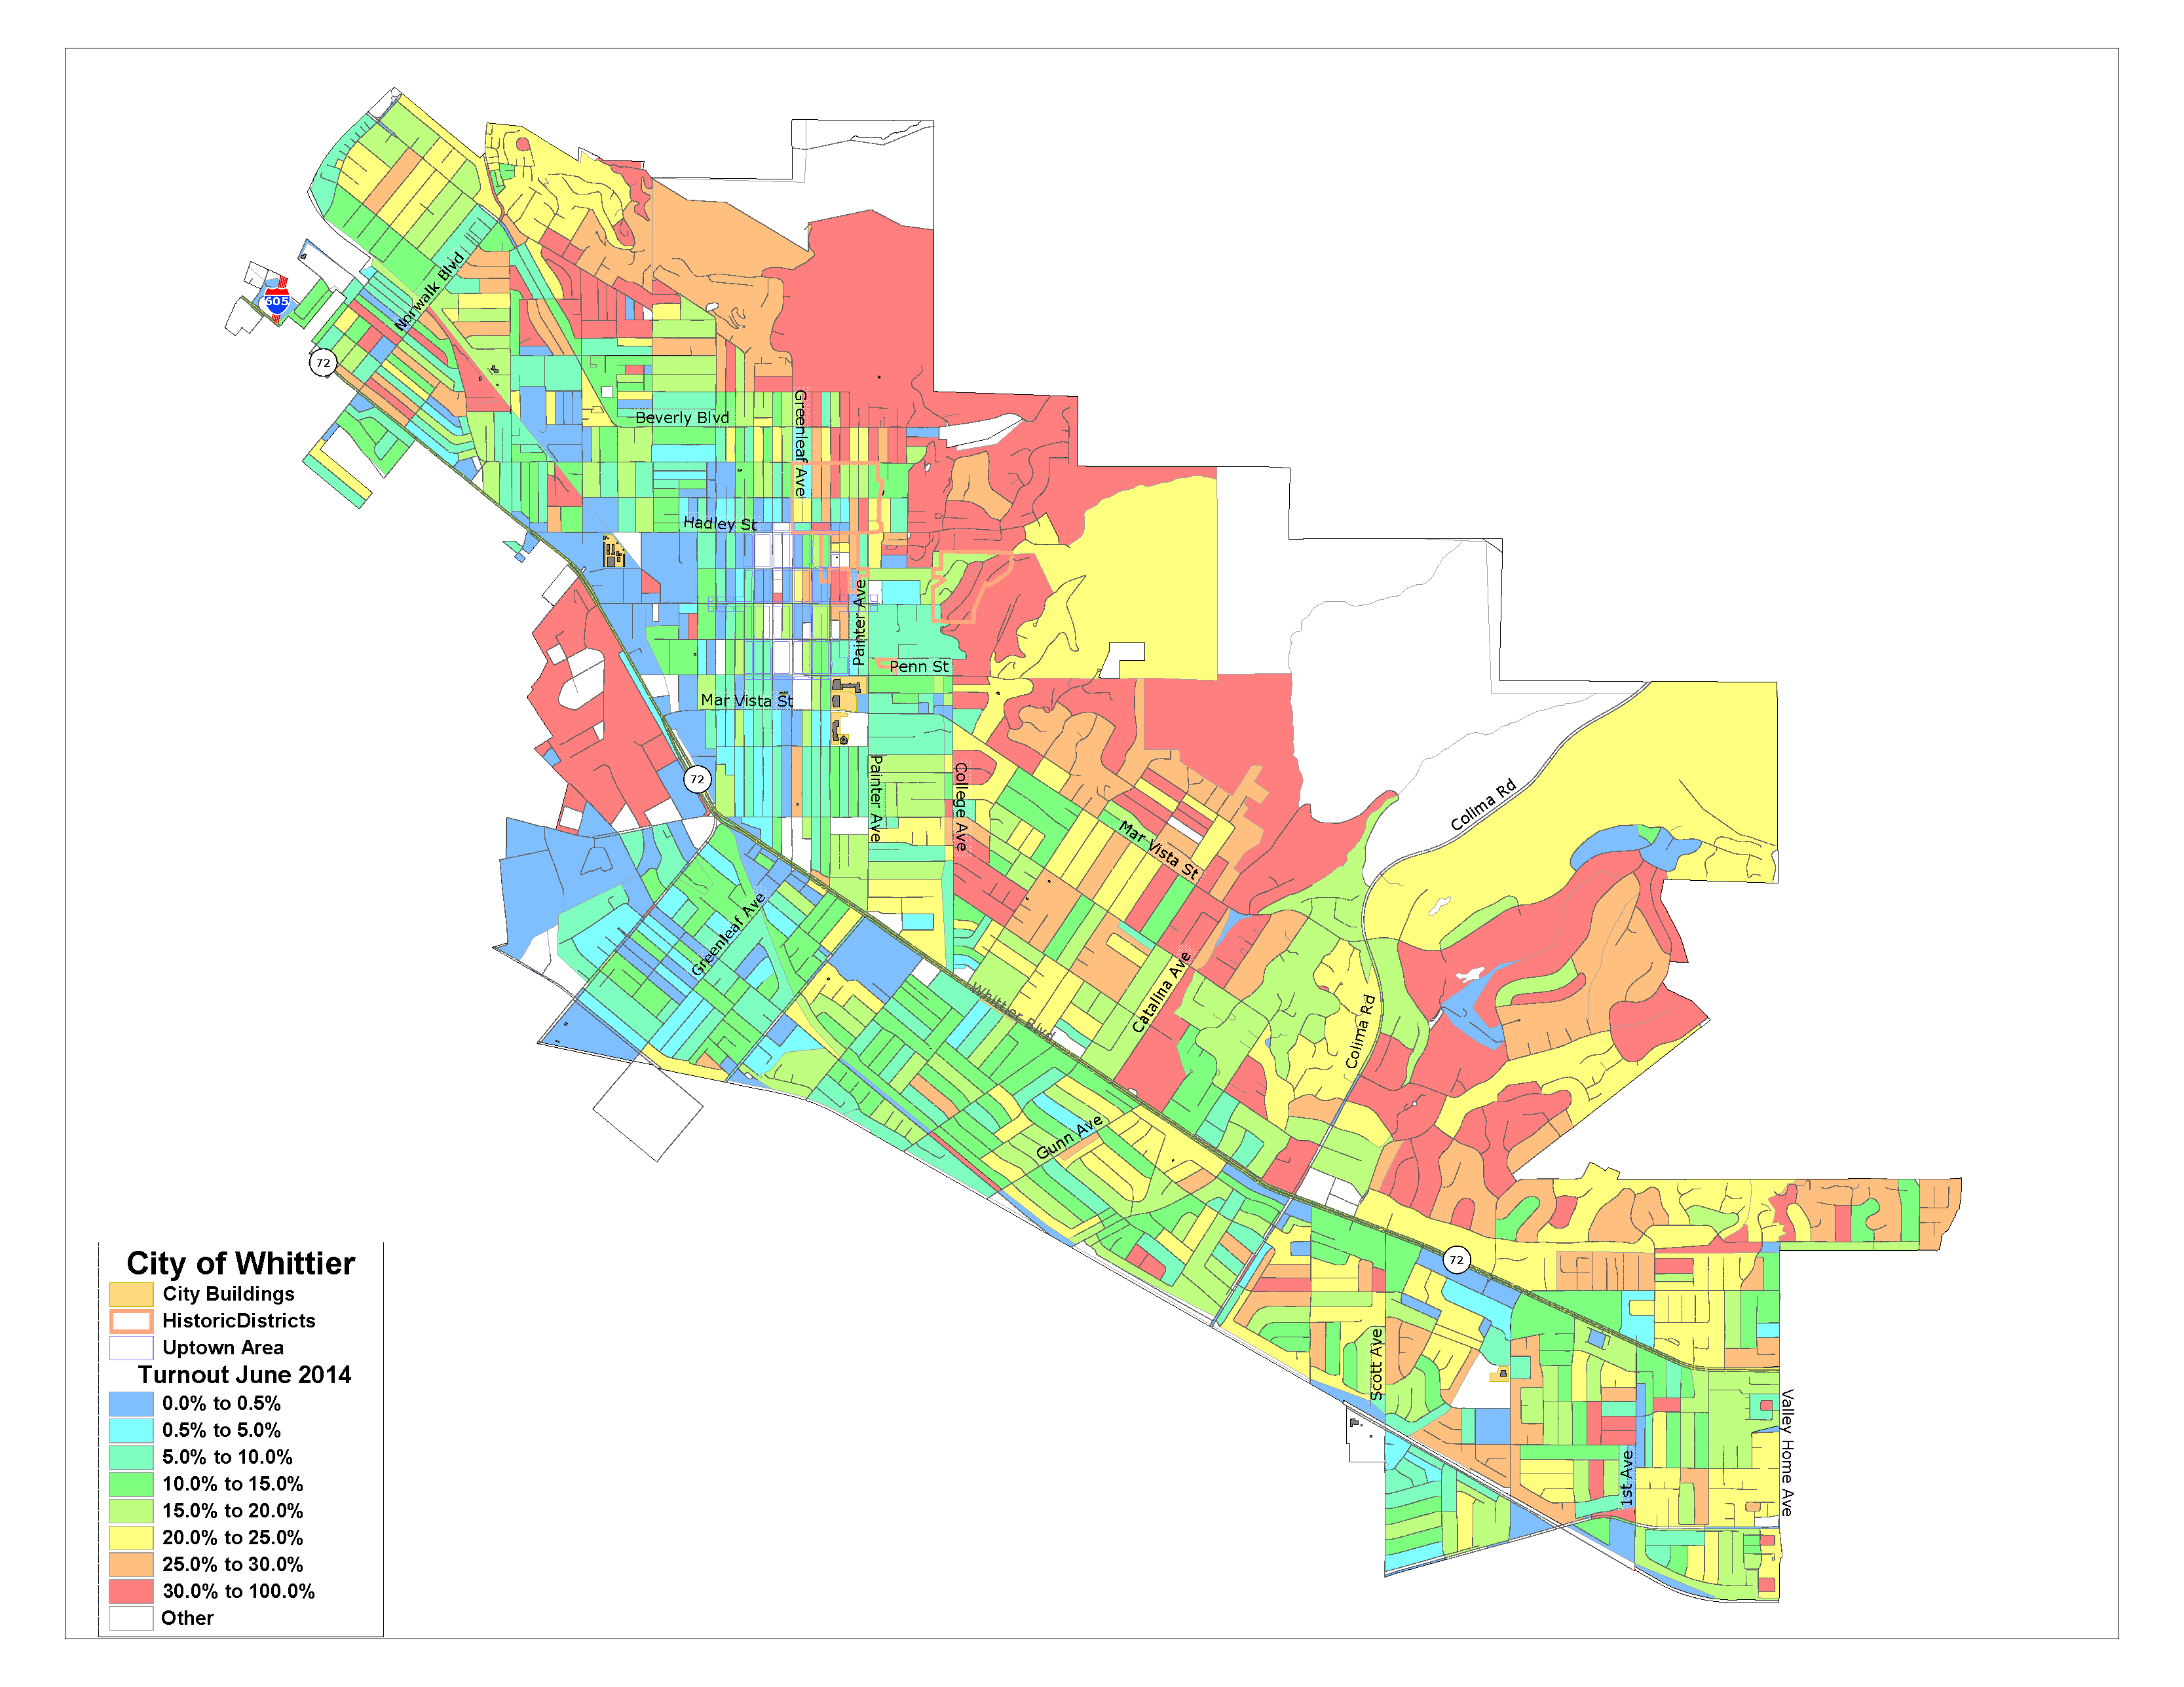
Turnout
Notes:
Dave

Slide 12
Sample Plan Spectrum
Socioeconomic
Geographic
Green Map | Orange Map | Red Map | Purple Map | Blue Map
Notes:
Dave

Slide 13
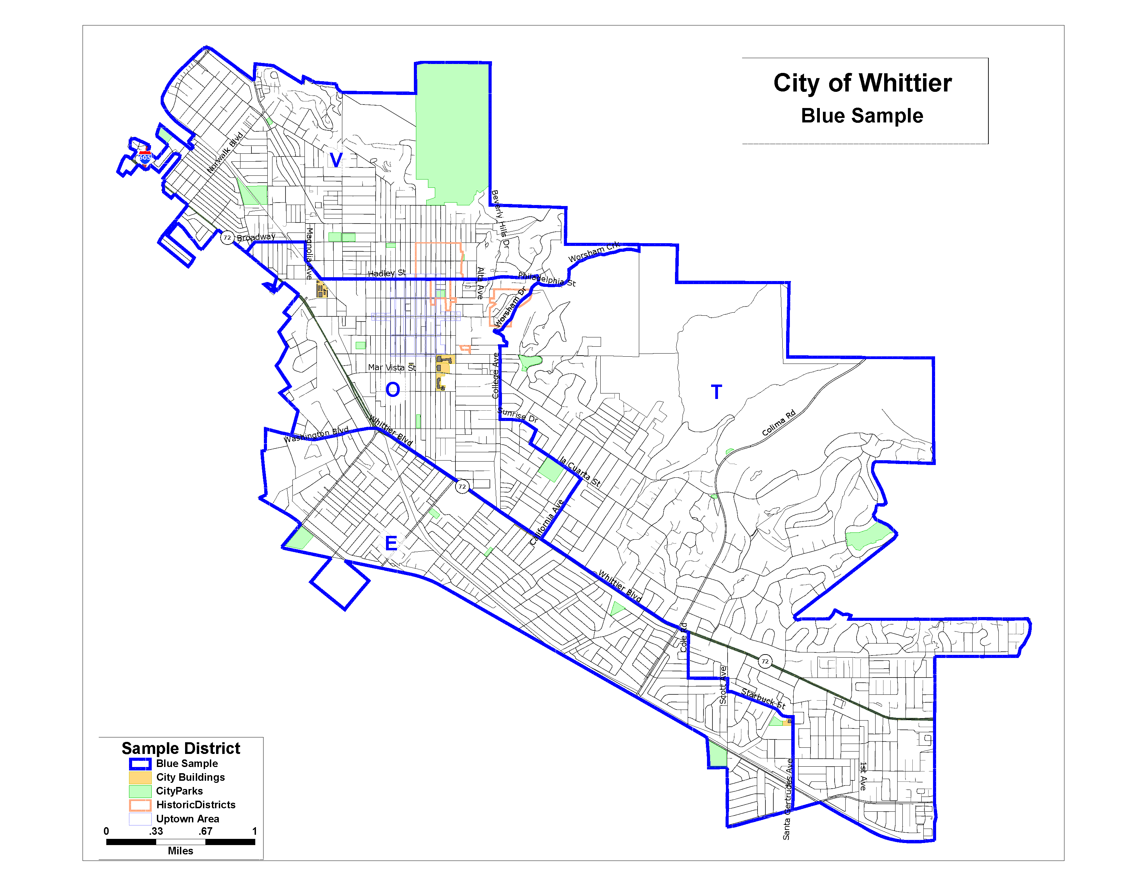
Blue Sample
Notes:
Dave

Slide 14
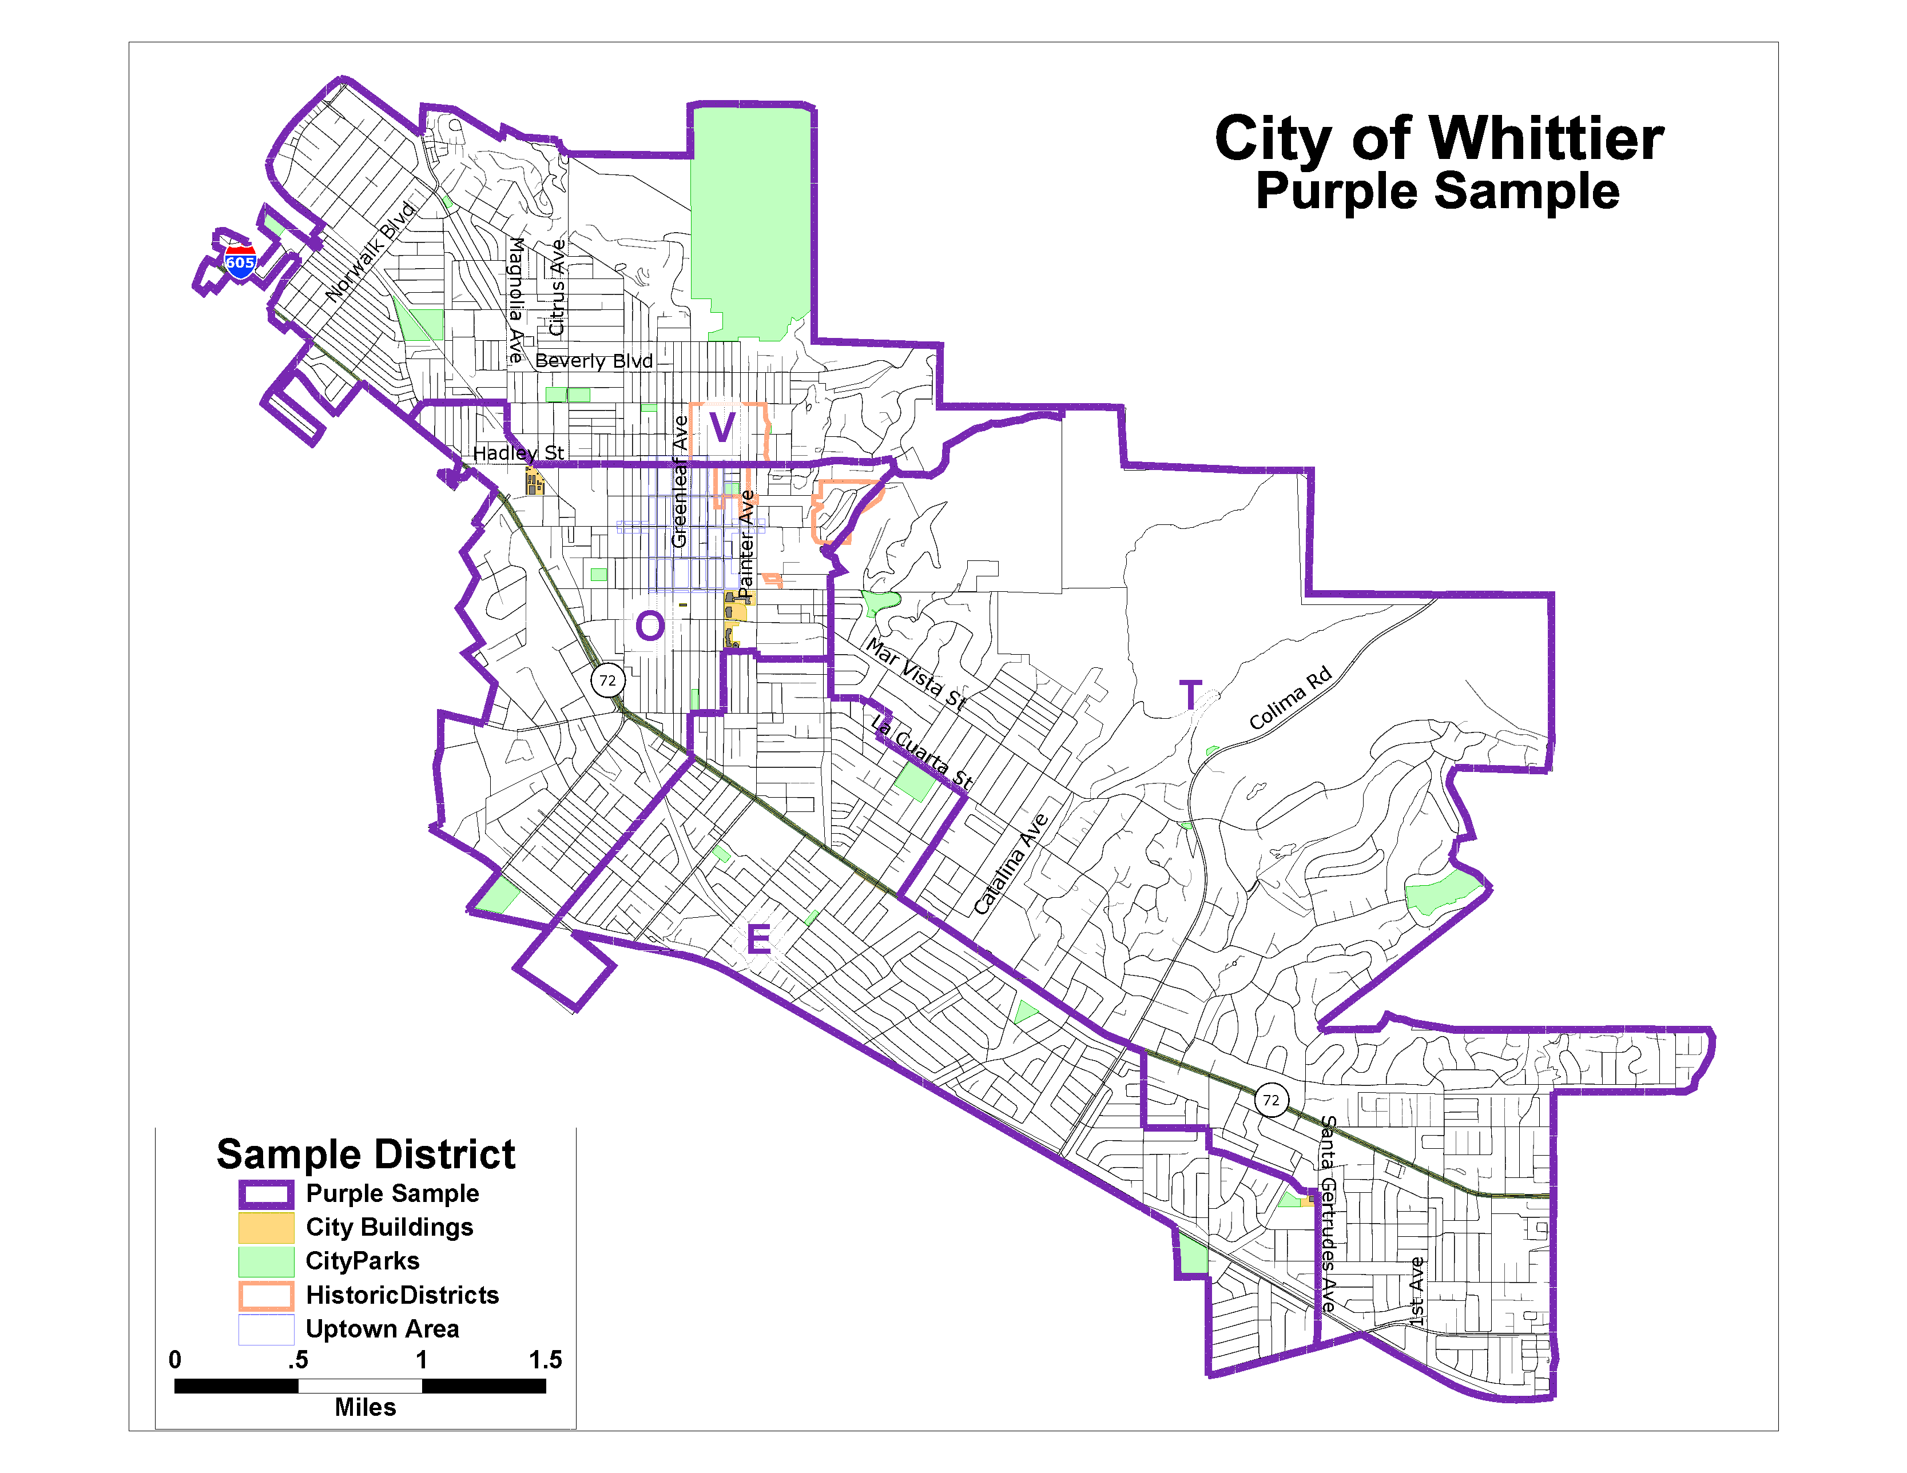
Purple Sample
Notes:
Dave

Slide 15
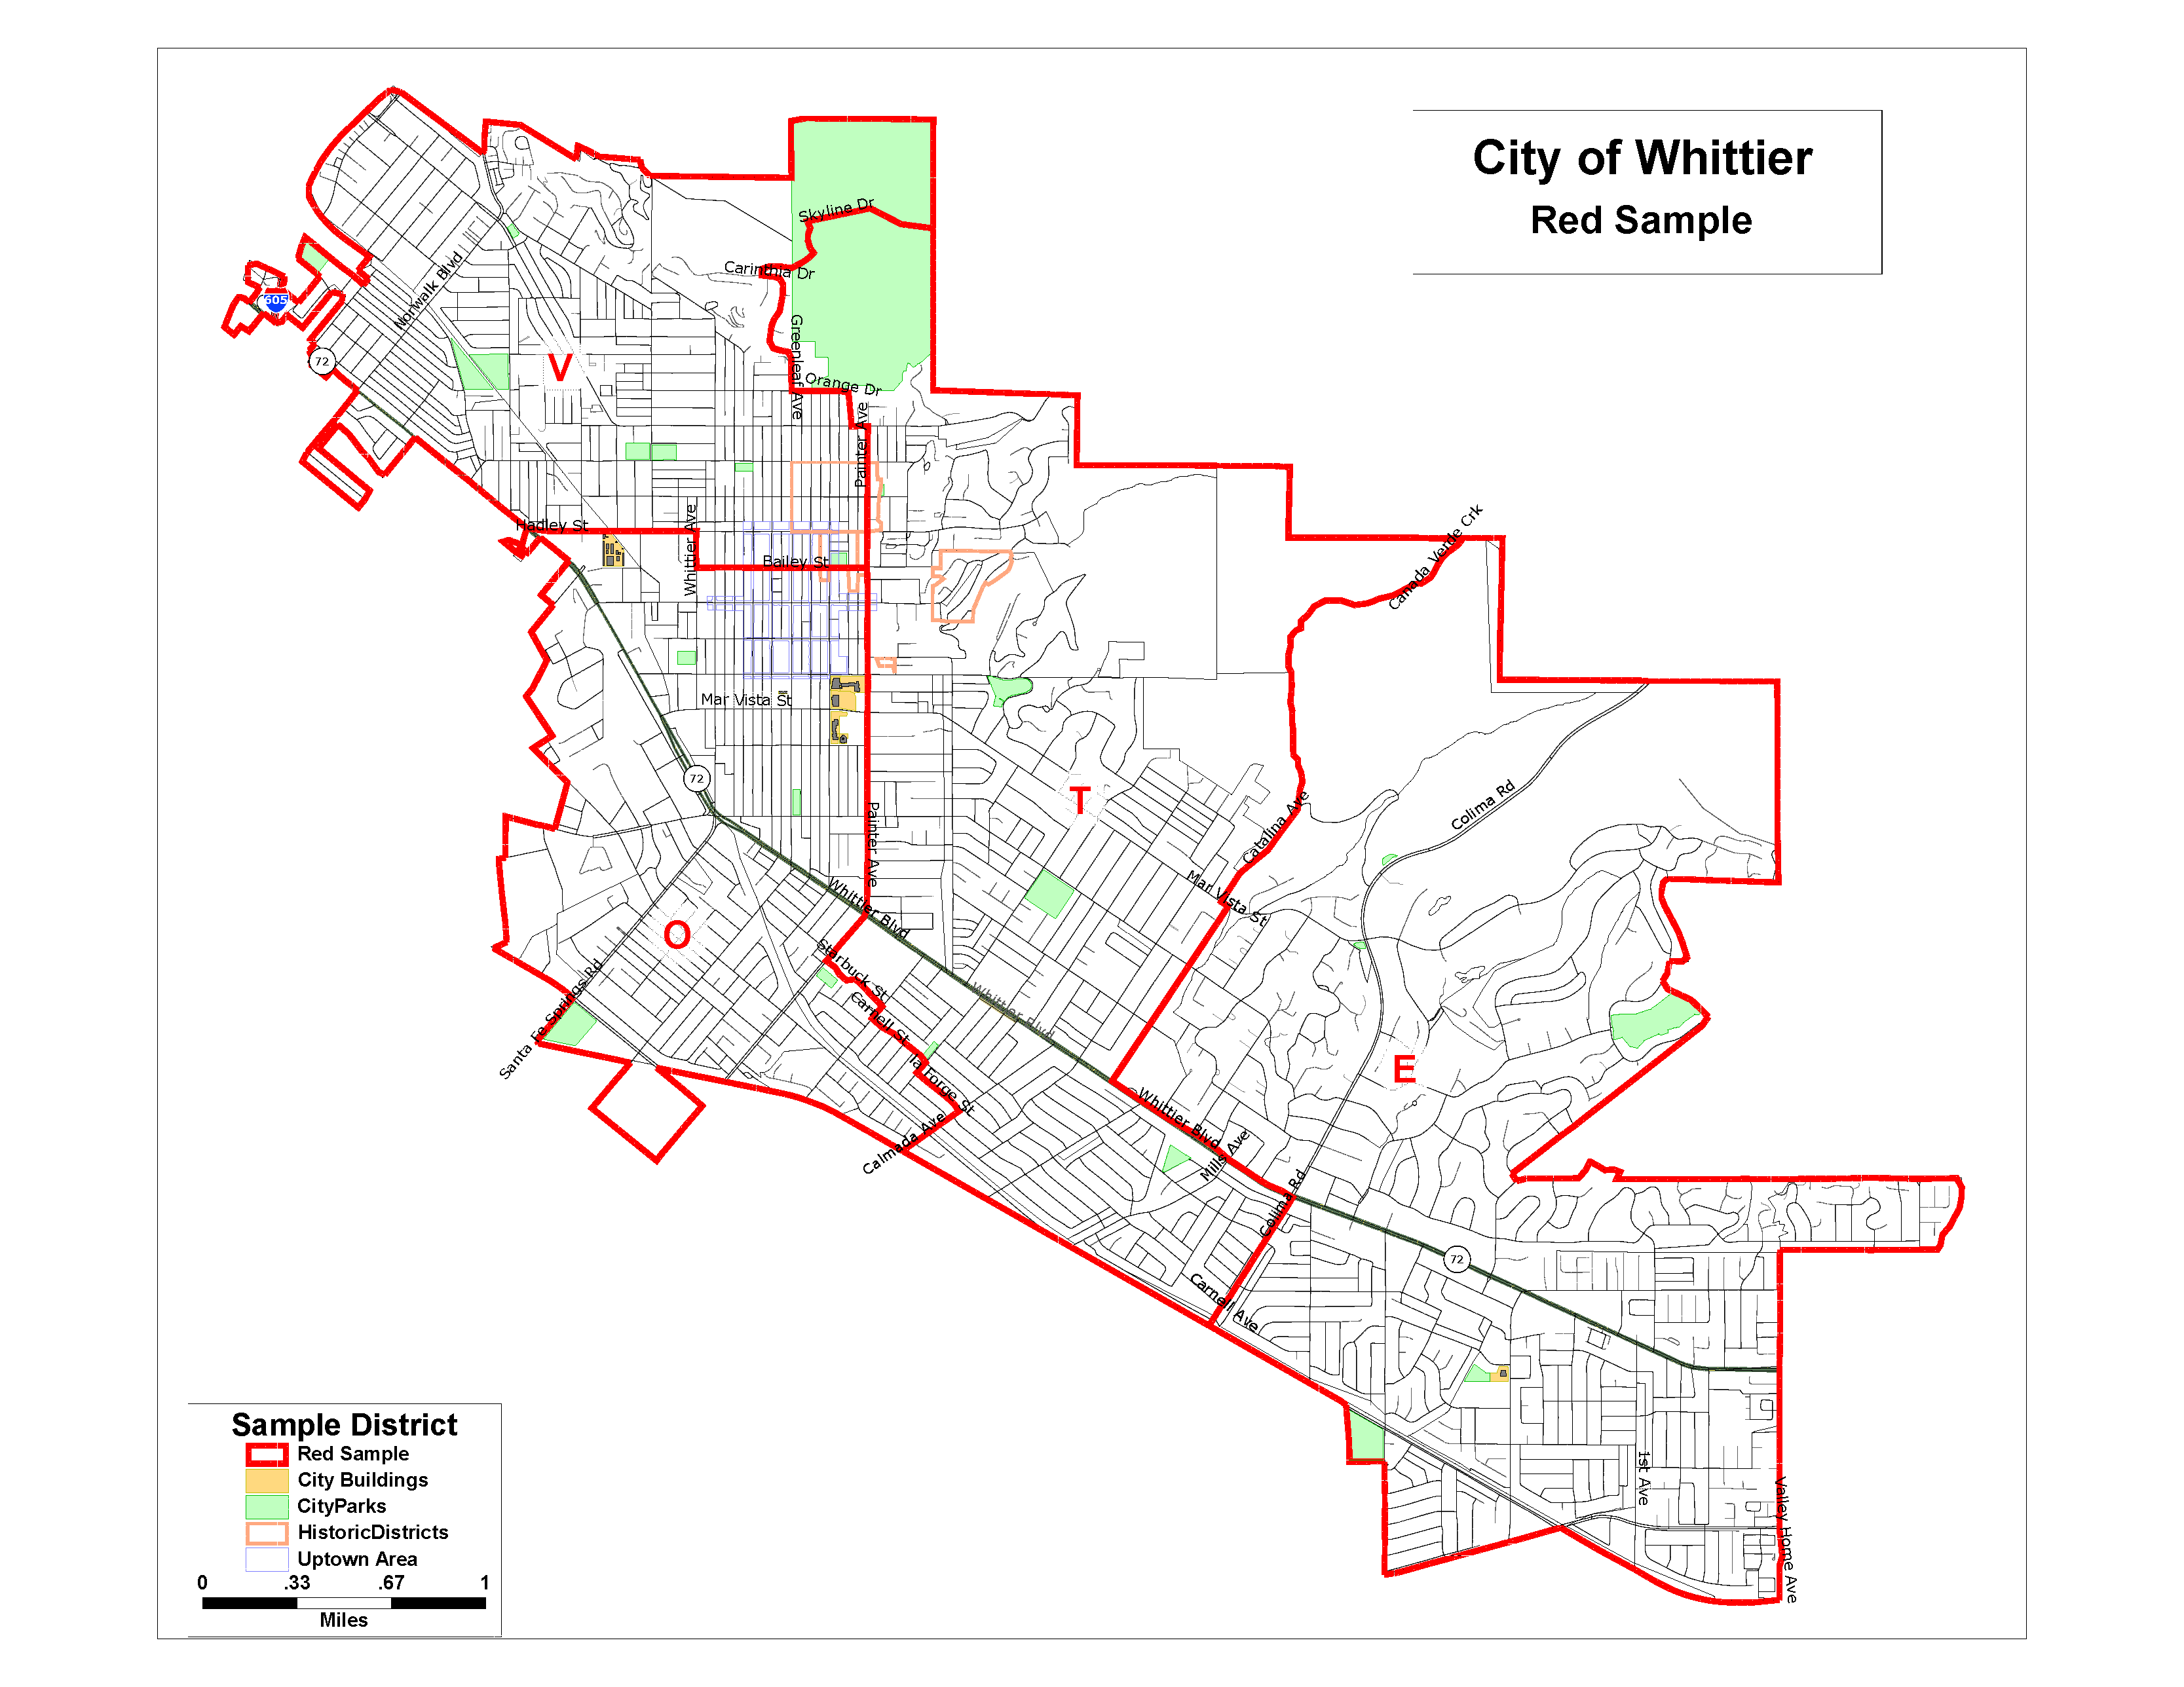
Red Sample
Notes:
Dave

Slide 16
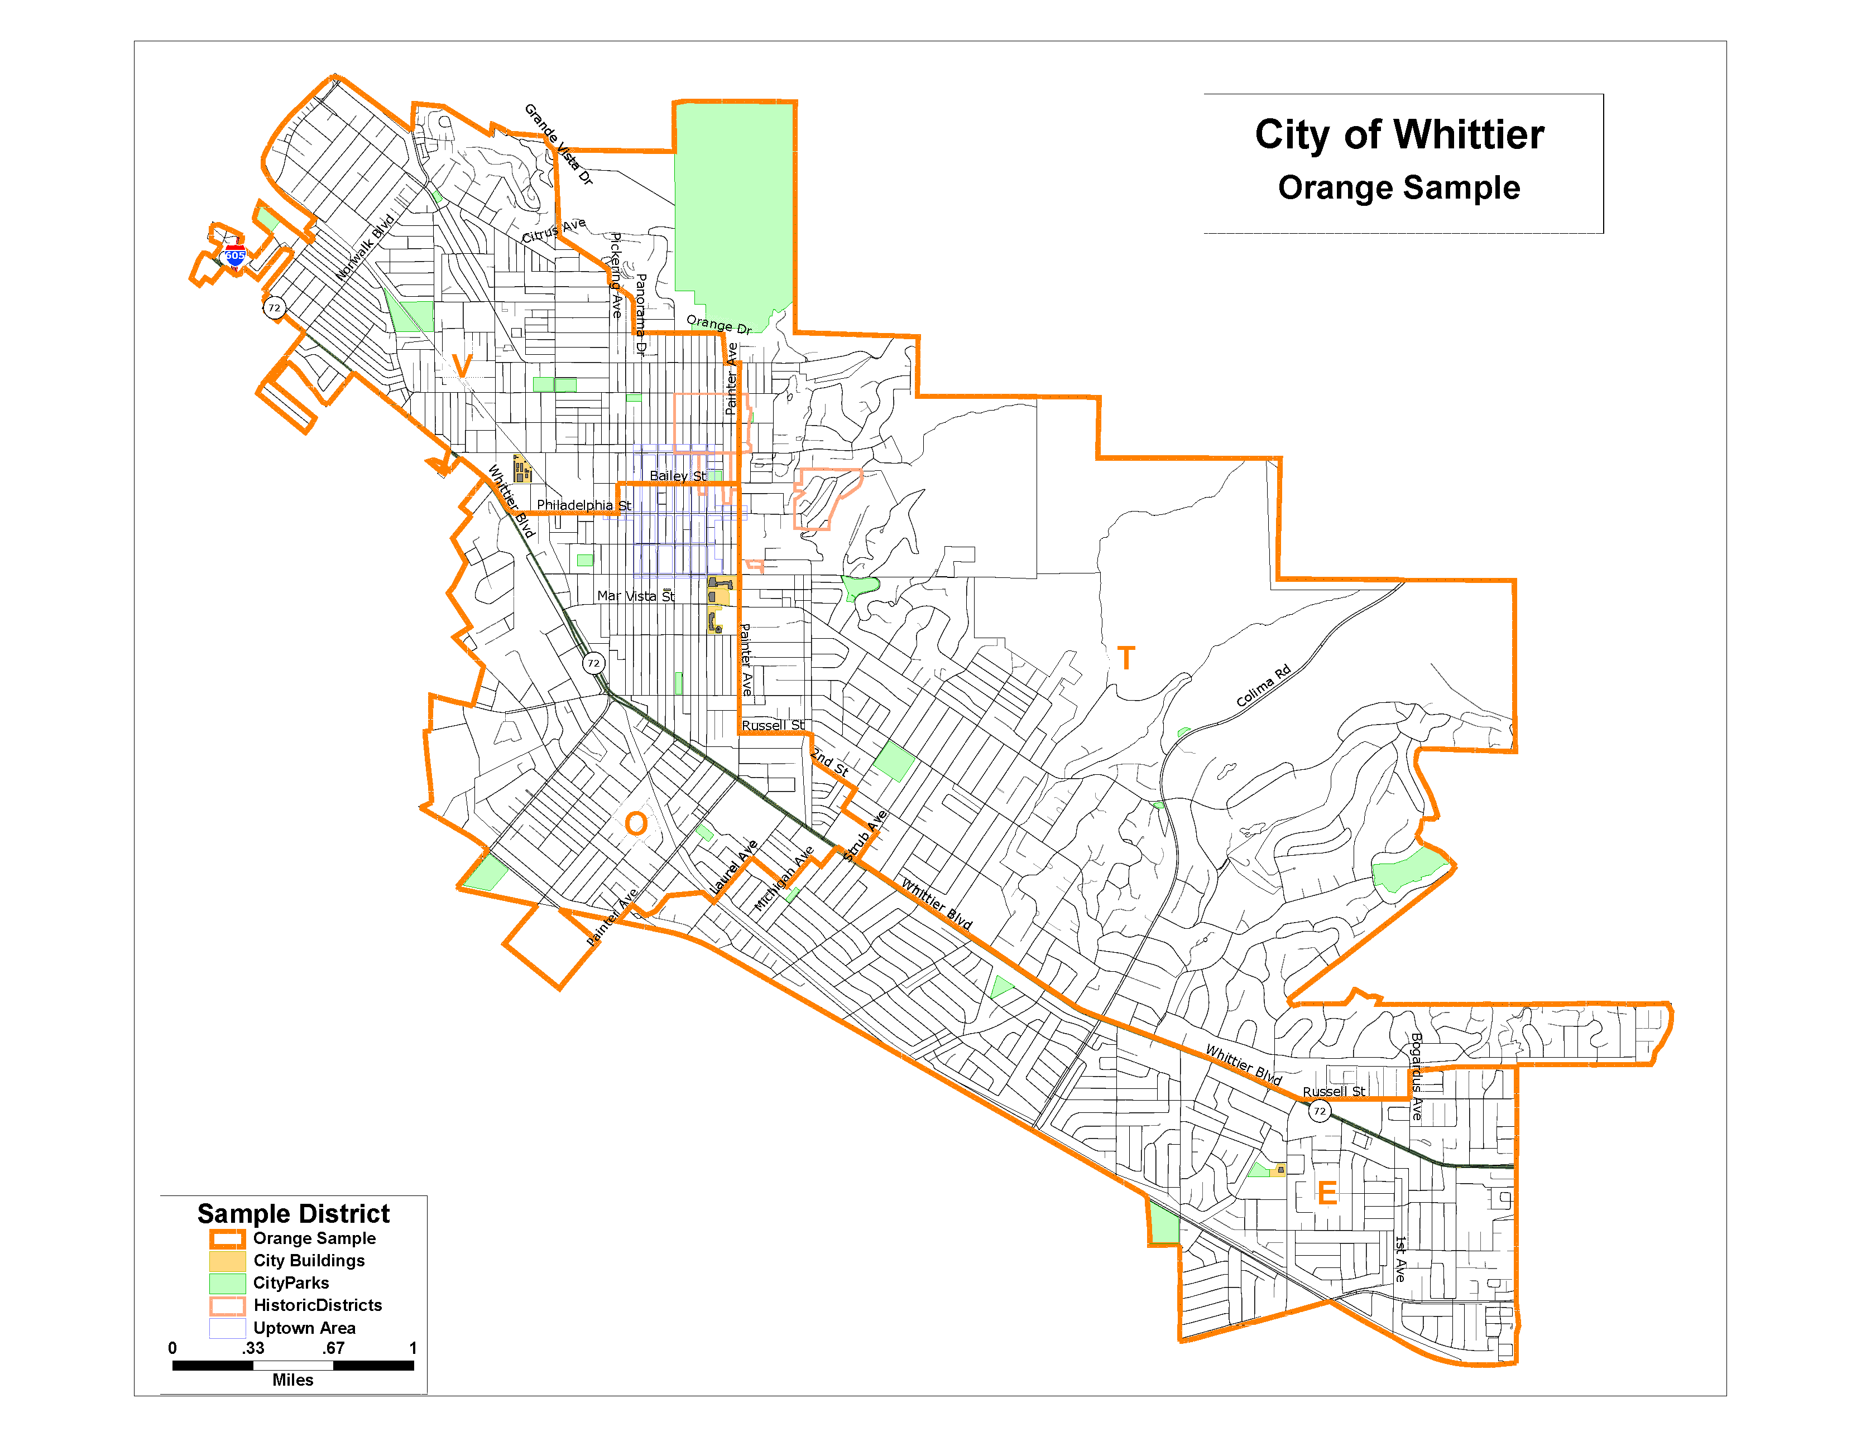
Orange Sample
Notes:
Dave

Slide 17
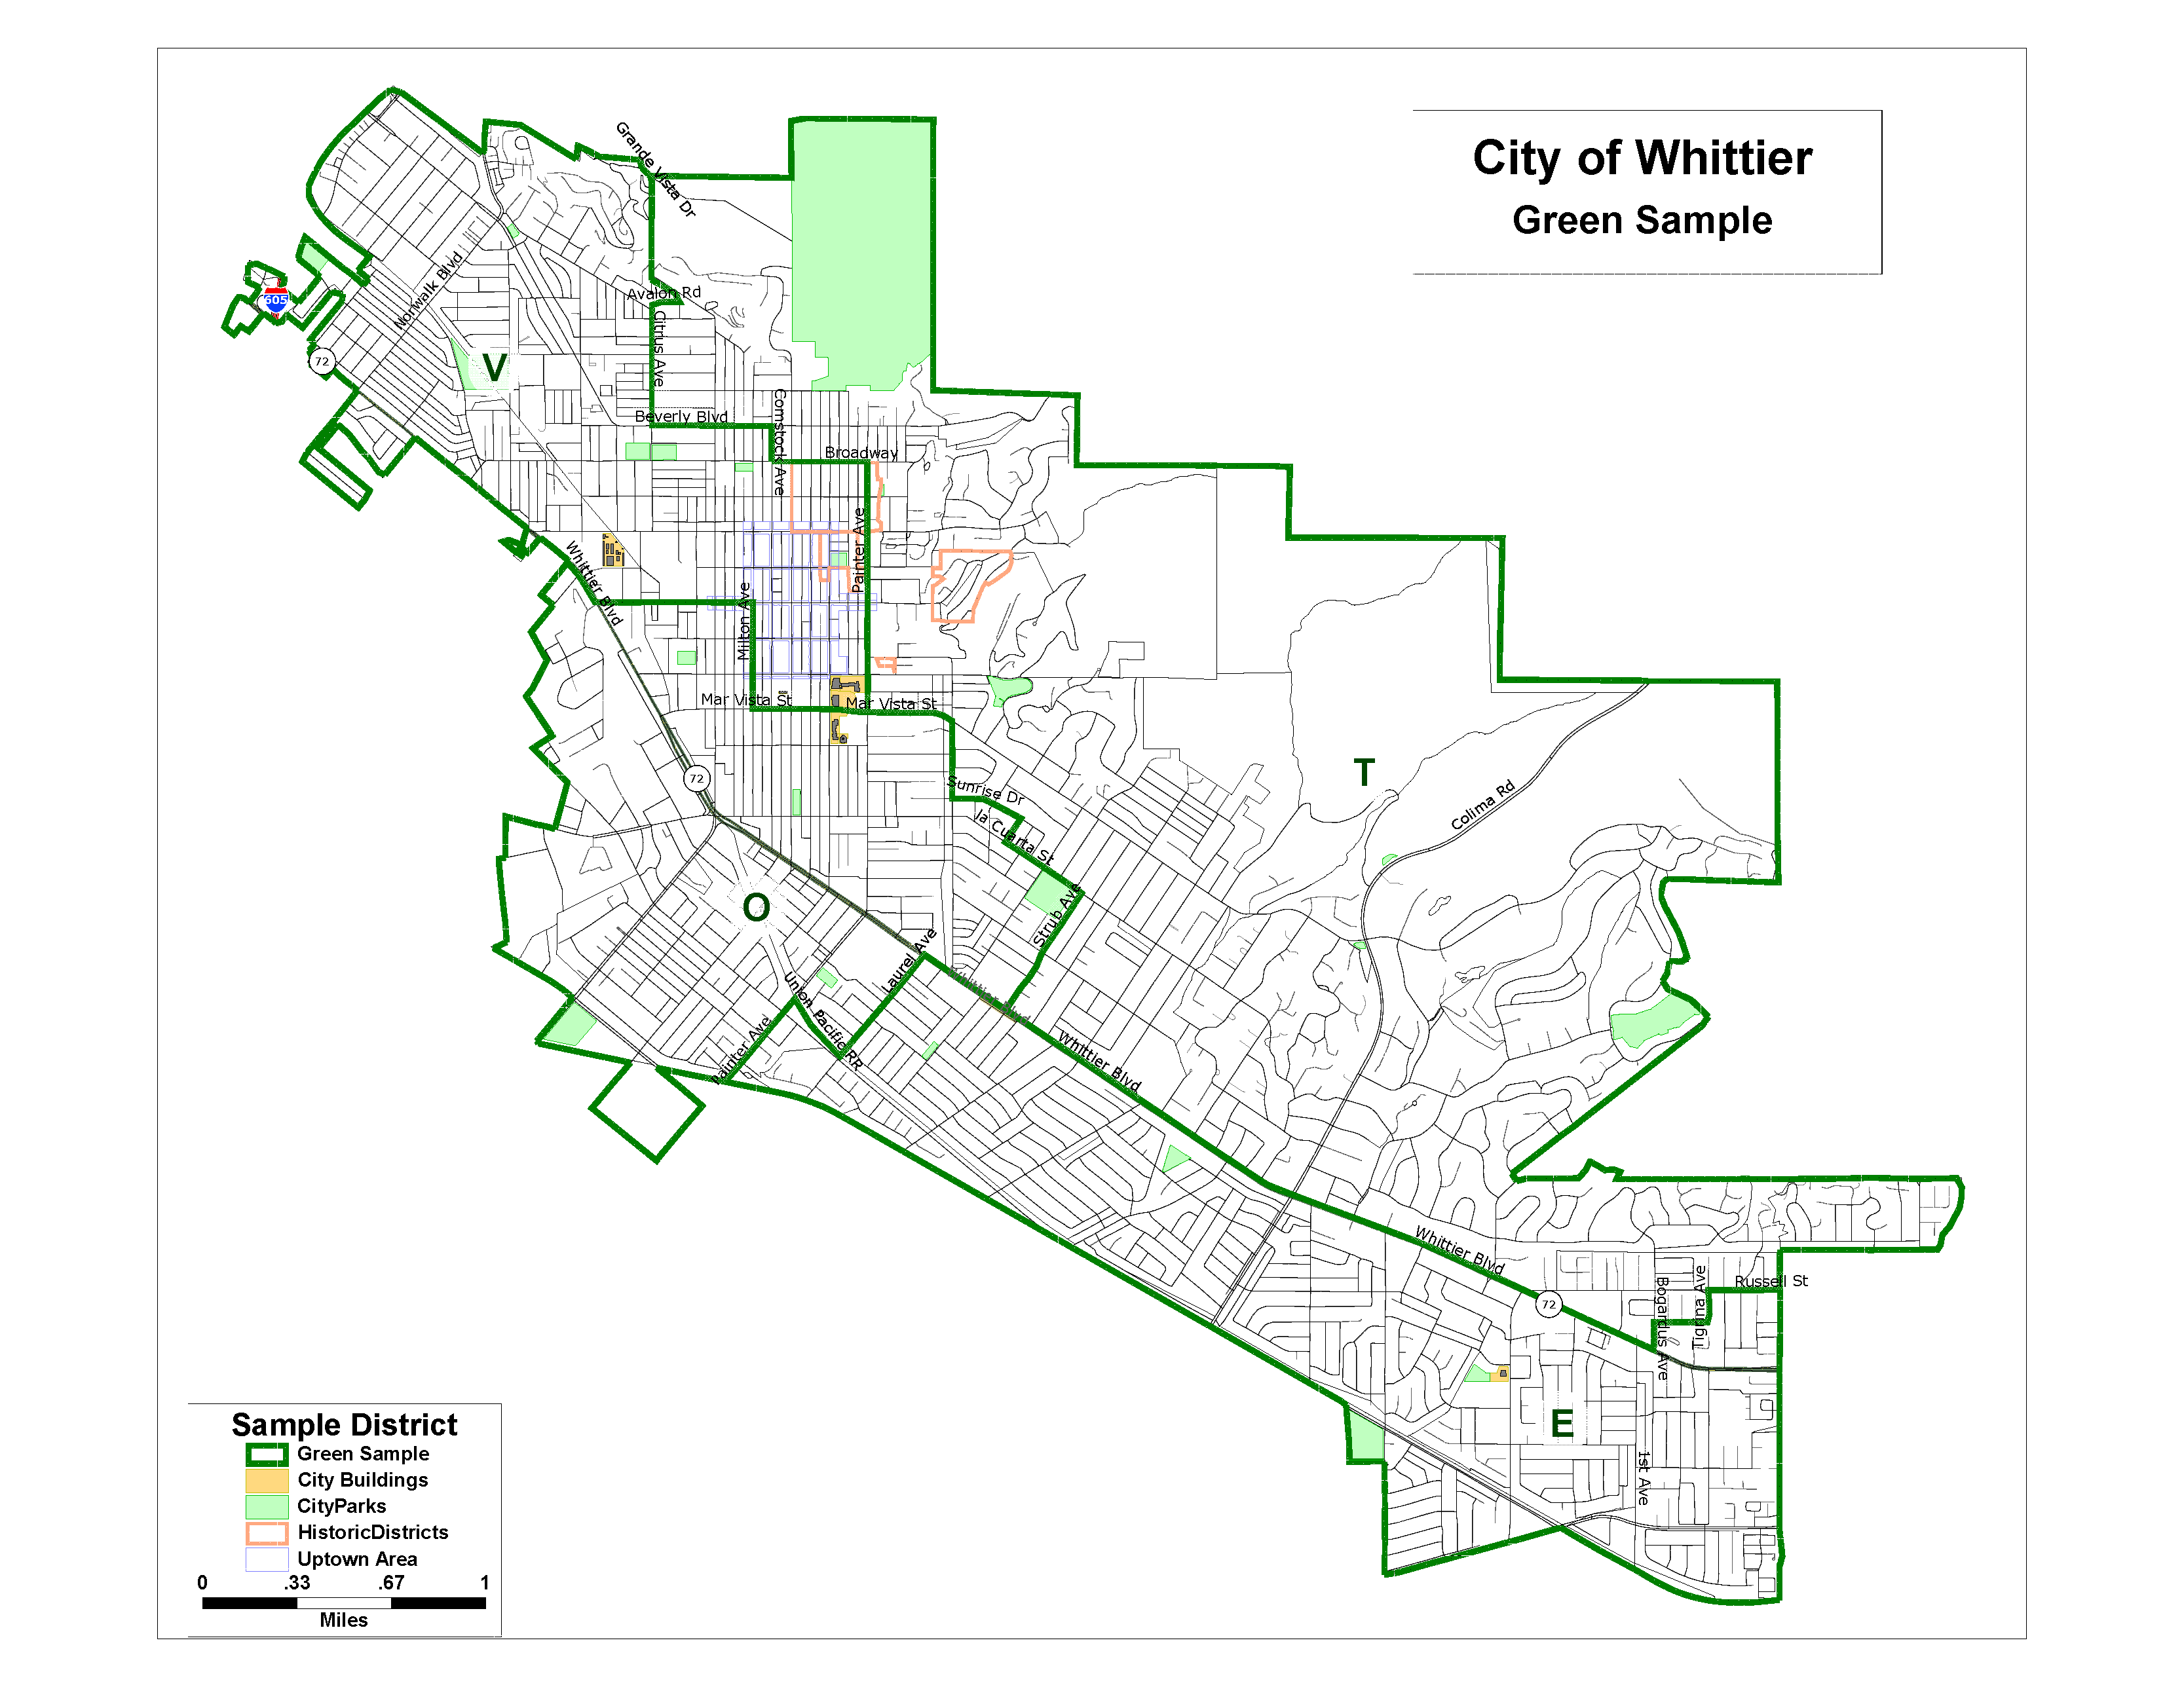
Green Sample
Notes:
Dave

Slide 18
What Happens Next
Review community input and technical analysis
City Council Public Hearing, Dec 9, 2014
Present results and proposed maps
Receive public input
Round 2, early 2015
Community meetings and Meet the Expert one-on-one
City Council Public Hearing, March/April 2015
Present final analysis with recommendation for the adoption of four voting districts to City Council
Notes:
Show this slide at the wrap up phase, once the tables have provided their feedback

Slide 19
Stay Involved
Visit the VDF webpage for additional details, sign up to receive updates and meeting invitations at www.cityofwhittier.org/vdf
Submit a Districting Map via:
Mail to: City of Whittier, Attn: Kathryn Marshall, 13230 Penn St. Whittier, CA 90602
Email : districts@cityofwhittier.org
Fax: (562) 567-2870
Notes:
Show this slide at the wrap up phase, once the tables have provided their feedback

Slide 20
Group Exercise
Workgroups of 8 – 10 participants per table
Use table map to identify:
Neighborhoods or communities
Connections
Barriers
Divisions
Points of interest
Review and prioritize sample maps
Report group findings
Questions & Answer
Notes:
Yesenia
Now that Dave has described the data analytics and criteria to develop the districts, we would like to hear from you.
During this group exercise we’re hoping to understand Whittier as you see it, we’re hoping to learn more about your perspectives regarding the following:
What areas make a Community and Neighborhoods?
What neighborhoods or communities should remain together based on common interests
What streets or major boulevards make sense to use as barriers

Slide 21
Stay Involved
Visit the VDF webpage for additional details, sign up to receive updates and meeting invitations at www.cityofwhittier.org/vdf
Submit a Districting Map via:
Mail to: City of Whittier, Attn: Kathryn Marshall, 13230 Penn St. Whittier, CA 90602
Email : districts@cityofwhittier.org
Fax: (562) 567-2870

